Slide 1



Slide 2
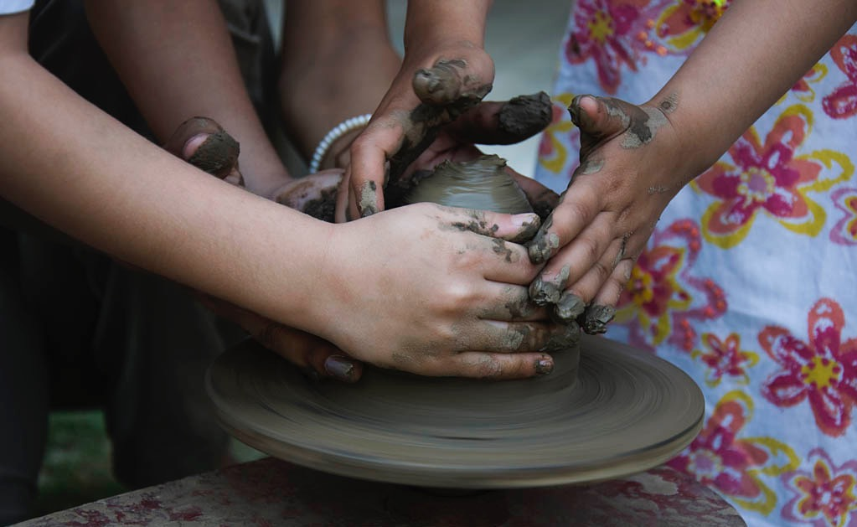
“Learning is the only thing the mind never exhausts, never fears, and never regrets.”
- Leonardo Da Vinci

Slide 3
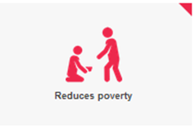
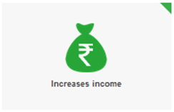

The Power of Education
Quality Education + Holistic Development = Sustainable Change
If all students in low-income countries left school with basic reading skills, 171 million people could be lifted out of poverty. This is equal to a 12% cut in global poverty.
One extra year of schooling increases an individual's earnings by up to 10%.
Each additional year of schooling raises average annual GDP growth by 0.37%.
One additional school year can increase a woman's earnings by 10% to 20%.
Wages, agricultural income and productivity are higher where women involved in agriculture receive a better education.
Children of educated mothers are more likely to be vaccinated and less likely to be stunted because of malnourishment.
If all girls had secondary education, child marriage would drop by 64%.
If all mothers completed primary education, maternal deaths would be reduced by two-thirds, saving 189,000 lives.
Notes:
GEM Report, p. 8
GEM Report, p. 7
GEM Report, p. 19
GEM Report, p. 6
GEM Report, p. 35
World Bank, Understanding Civil War, p. 34
World Bank, p. 3
GEM Report p. 4
Education Transforms, p. 17
Education Transforms, p. 7
World Bank
UNICEF, The Education Vaccine Against HIV, p. 9

Slide 4

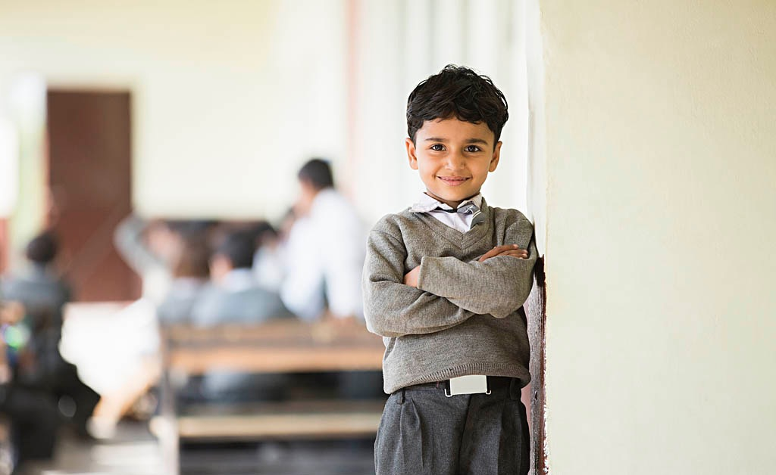
Structure
About Us
Key Domains
Connect

Slide 5


Slide 6


Vision
To foster a bright future where education
is optimally delivered
and learning is truly inspired.

Slide 7


Mission
Enhance:
Working with key stakeholders in education to enhance delivery and impact.
Enable last mile connect through network and partnerships.
Develop solutions that are customised and in keeping with the changing needs.
Engage:
Leverage technology to accelerate pace of change
Drive innovation for deeper learning and stronger enterprise.
Elevate:
Develop evidence based and well researched solutions and guidelines to raise the standards of education and empowerment.

Slide 8
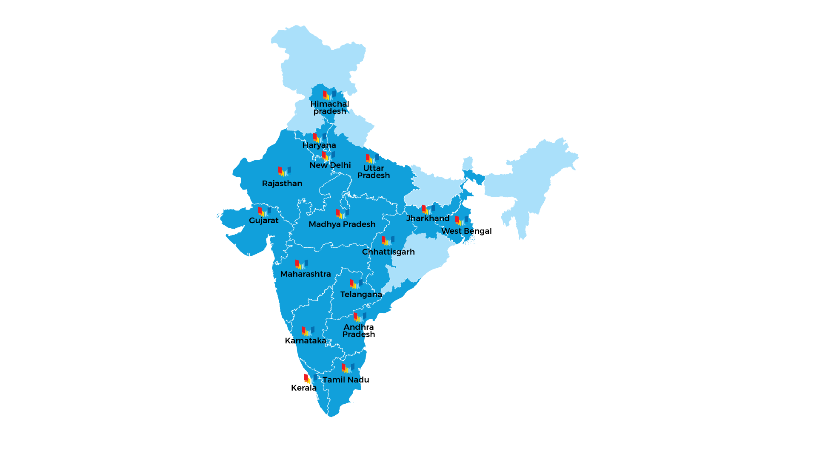
Presence
We are currently present in 16 states and have experience across 25 states
We currently have signed MOUs with 12 states and have a team of 500 members deployed across the Country

Slide 9


Journey
2002
Launch
2003
50,000 teachers trained
2004
Expanded foot print to South East Asia
2005
1st online collaborative project for students launched
2006
Community outreach – Supporting e-Gov and village Entrepreneurs
2007
2008
Launch of Higher Education programs: Linking curriculum to employability !
ICT Competency Standards for School Education

Slide 10

2009
1st Technology enabled School Transformation project Launched
2010
Me, Us and the Collective: Citizenship Education for Youth
2011
1 million Teachers trained
2012
Assessment for Learning: 100,000 Students Impacted
2013
Leveraging the power Web 2.0 to deliver quality in education
2014
Skill Development initiative launched in partnership with NSDC
2015
Addressing the Achievement Gap: Working with 15,000 children to develop grade level competencies

Slide 11

2016
Cyber Safety and Security programs launched: promoting safety and fostering security solutions
2017
Launch of Mobile Innovation Station: Tinkering on the move…

Slide 12





Rewards & Recognition
Haryana State Award by Haryana Government for supporting quality education in 2014
Ranked one amongst top 10 NGOs in the country for promoting volunteerism and volunteer engagement by iVolunteer in 2015
Outstanding Achievement in Online Safety by Family Online Safety Institute
Great Place to Work (India's top 10 NGOs by Great Place to Work Institute) in 2015
Featured in the top 32 NGOs (top 10 in Education Category) in the HCL Grant 2016-17
4th CSR Impact Award for Employee Volunteering - 2017

Slide 13


“Education is not the learning of facts but the training of the mind to think .”
- Albert Einstein

Slide 14


Slide 15
Our Domains
Education
Solutions
Skill Building & Entrepreneurship
We provide customized solutions to bridge the learning divide and empower students to achieve their potential.
We are devoted to equipping youth with skills for self-reliance and productive participation in society. We also provide need-aligned professional development for educators - empowering to transform learning
Technology & Innovation
Consultancy &
Advisory
We leverage technology to accelerate and deepen learning and foster collaboration. We stimulate change and create sustainable large solutions through innovation.
We are the trusted advisor on education strategy development, enabling systemic changes, and advocacy for reforms in practices and policies.

Slide 16

Education Solutions

Slide 17

Solutions
Whole School Transformation
Learning Enhancement Programs for Students
Subject Enhancement Programs
Customized Solutions
Outreach
Education Solutions
Students | Schools | Teachers
5,56,219 | 3,689 | 25,026

Slide 18
Example: Road to School*
Project Goal
Learning enhancement program for Primary and Middle school students across select Government Schools using a sustainable and scalable model
Nurture both scholastic and co-scholastic development of children from Government Schools
Holistic Child Development covering Health, Hygiene, Physical & Emotional development
Intervention
Analyze: Understand ‘What Must Change’
Implement: Conduct activities to ‘Make Change Happen’
Measure: Report on the ‘Impact of Change’
Outcome
Learnings improvement ranges from 29 to 40 %
~ 20% reduction in drop out rates
95% of students passing out from 5th grade have taken admission in middle schools
Improved student learning level outcomes in English, Science, and Math
21st century skills among students and community children
Learning enhancement
Health & Hygiene
Sports & Life Skills
*Supported by Ashok Leyland

Slide 19


Skill Building & Entrepreneurship

Slide 20

Solutions
Youth Empowerment Series for Micro Entrepreneurs
Student and Teacher Empowerment Program
Customized Solutions
Outreach
Skill Building & Entrepreneurship
Students | HMs | Teachers | Armed Forces | Youth
136,83,587 | 24,975 | 21,22,559 | 31,200 | 1,23,843

Slide 21
Youth Empowerment Series for Micro Entrepreneurs
Project Goal: Alleviate the employability and employment generation challenge in urban centres to improve economic condition of youth. Train, Mentor and Support youth from urban poor neighborhoods to become entrepreneurs by helping them create strong business case and obtain funding from financiers. Age group 18-32 years, low income families
Project Intervention
Mobilize: Partner with organizations working with youth & work with funding agencies to mobilize target group
Training, Mentor and Support:
Classroom training on Entrepreneurial skills, Communication skills, digital literacy and financial literacy
Idea incubation boot-camp for strengthening business plan
Exposure visits
Measure training impact for each module
Funding: Initial/ seed funding for business plans (in-principal agreement by investors to finance their entrepreneurial venture)
Outcome
2400 youth trained across 4 locations
1000 confident entrepreneurs
full-time job opportunities to 400 youth

Slide 22
Skill Building for Educators
Project Goal: Improve the quality of education and foster high academic and professional standards through high impact sustained professional development of teachers and educators.
Conduct path-breaking research to understand the needs of the stakeholders in education & build sustainable models of education growth by enabling excellence in the education professionals
Project Intervention
Analyze: Understand ‘What Must Change’ in practice, resources and outcomes. Compare with current
Implement: Conduct activities to ‘Make Change Happen’, Mentor Teachers, support classroom practices and “walk the talk”
Measure: Report on the ‘Impact of Change’ by using learning outcomes of students as a measure of success
Outcome
2400 youth trained across 4 locations
1000 confident entrepreneurs
full-time job opportunities to 400 youth

Slide 23


Technology & Innovation

Slide 24

Solutions
Technology Integrated Education
Digital Citizen (Digital Literacy, Cyber Security, Web 2.0 tools and technologies)
Technology innovation (Tinkering Lab, Hackathon)
Customized Solutions
Outreach
Technology & Innovation
Students | Teachers | Community
9,22,699 | 43,383 | 1,88,619

Slide 25
Technology Integrated Education
Introduction technology-integrated educational solutions enable and accelerate technology innovation in schools and communities for improved learning outcomes.
Intent seeks to (a) leverage emerging technologies to increase collaboration, knowledge-sharing, and develop 21st century skills and (b) bridge the learning divide with intensive community outreach
Intervention
In-school: Empower students with technology skills and 21st century skills; Empower teachers with technology skills and pedagogy skills (Science, Math); Provide supporting infra such as digital learning centers- laptops, wifi, digital content, Science kits and Math kits) to create an engaging learning environment; Cloud-based system with subject-specific online content)
After-school (Community Outreach): Prepare community children for digital age readiness by building digital literacy skills and spoken English skills
Monitor & Evaluate: Class observations, Baseline study for students, End line study for students
Outcome
Increased learning levels in Science and Math
Improved technology skills and 21st century skills
Reformed teaching-learning practices
Bridging of skill gap between school children and community children

Slide 26
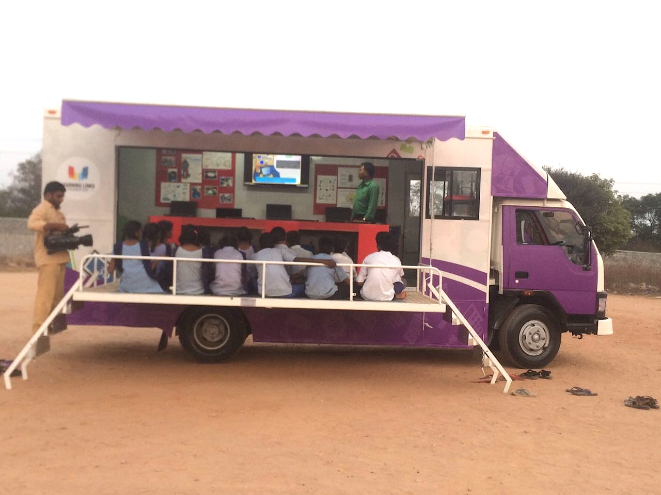
Mobile Tinkering Station Reaching – over 50 schools to make high-tech innovation accessible to underprivileged students

Slide 27
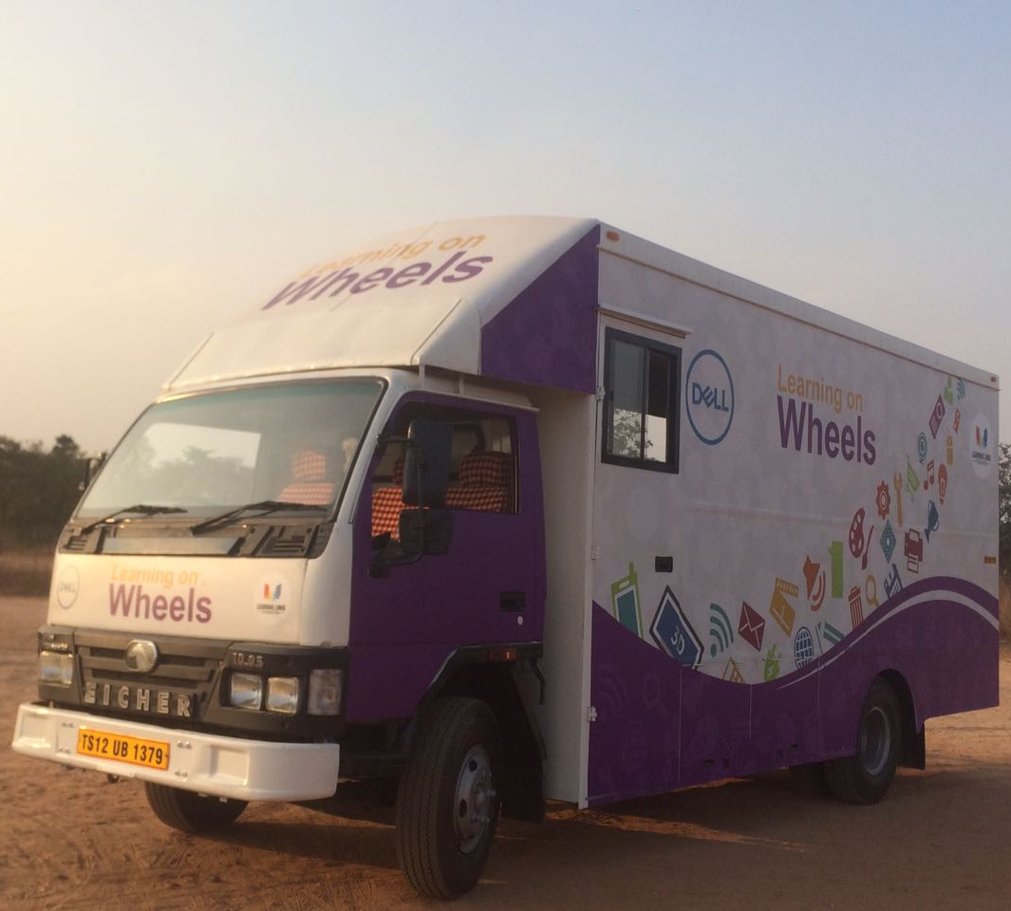
13 schools under the program have been selected by Niti Ayog to set up Atal Tinkering Lab

Slide 28
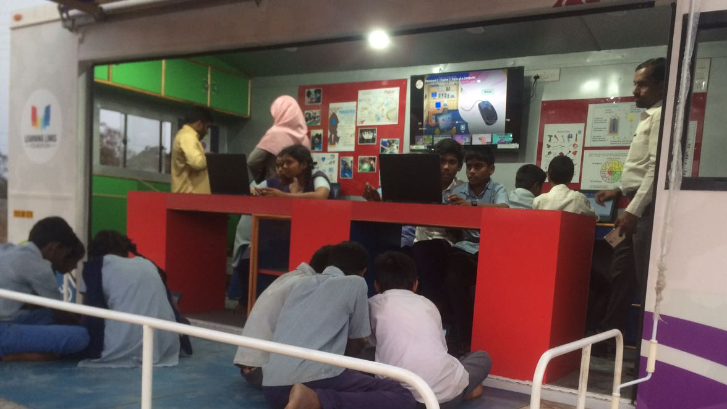

Slide 29

IMPACT
Impact
Over 99% attendance across all intervention schools due to the adoption of technology
Over 90% of the children in our intervention schools are able to code, to develop websites and apps
Over 450,000 youngsters are following safe internet and online practices
Over 50,000 youngsters are safely managing their social media proﬁles

Slide 30


Consultancy & Advisory

Slide 31

Solutions
Canvas the importance of quality in education, skill building, enterprise development and technology adoption across the eco-system
Develop theories of change and create interventions to improve education outcomes
Promote Child rights, child safety across all learning experiences
Undertake research to identify gaps in learning, innovation and enterprise development
Facilitate collaboration of all beneficiaries
Measure impact to refine strategies

Slide 32

Impact
Over 20 partner organizations successfully implement their education initiatives across the globe
Over 500 LLF team members work on education projects at any given time
100 projects across 25 States have been completed over the past ﬁfteen years

Slide 33

“Education is the kindling of a flame not the filling of a vessel.”
- Socrates

Slide 34


Slide 35
Where Inspiration meets Implementation (Digital Citizenship)
Each school appoints a teacher for the mid-day meal management. In some schools they customise the mid-day meal menus, whereas in most schools, the menus are already outlined as per the government directive. Any teacher who is in charge of the store maintenance has to spend at least 2-3 hours for this task and would often miss taking their subject classes.
“We read in the papers that this task of mid-day meal [computation ]is difficult’, said Balaram, ‘so taking into account this issue, we thought we will do something about it and find a solution’.
Shiva, Balram, Amit and Indrajeet – 10th graders at Government Senior Secondary School, Carterpuri in Haryana, developed the mid-day meal monitoring app. (now available at the Google Play Store)
Learning Links Foundation role:
Gyan Shakti Program
Smartclass
App development
Collaboration and English speaking

Slide 36
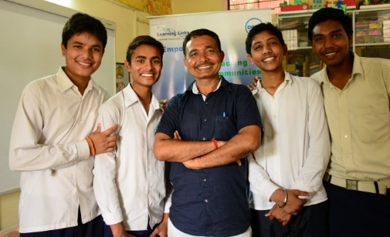

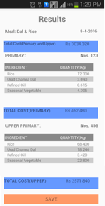
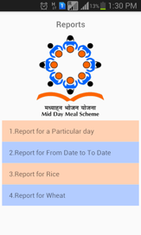
Where Inspiration meets Implementation (Digital Citizenship)
Shiva, Balram, Amit and Indrajeet with Mr. Manoj Lathia, their teacher.
The mid-day meal monitoring app. (now available at the Google Play Store)

Slide 37
Volunteer Initiatives
Student Mentorship Programs - Mentoring students on technology , math and science projects
Development of 21st century skills – Workshops on life skills, values, technology, communication, thinking skills
Enabling a Conducive School Environment – Turning school building into a teaching aid, painting of classroom corridors with subject concepts, white washing & painting of walls & ceiling
Empowerment of Teachers & Students – Expert lectures, career counselling & workshops on emerging trends in industry
Preparation of TLM - Teaching aids for school teachers
Awareness campaigns – Organizing and conducting campaigns to create awareness on issues concerning environment, health, safety etc.
Helping the physically disadvantaged communities – Creating audio books and being scribes for physically challenged students
Celebration of Important Days – Making students understand the importance of National/ International days being celebrated
95,000 hours clocked

Slide 38
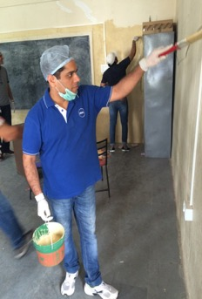
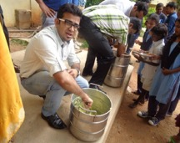
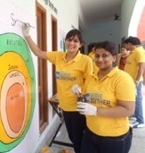
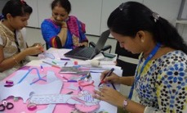
FEET ON STREET. HEARTS ON GROUND.

Slide 39



Our Partners

Slide 40
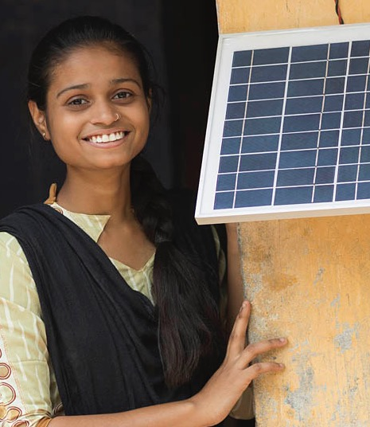
NEXT STEPS
How can we partner…

Slide 41

THANK YOU
Learning Links Foundation
1209, Padma Towers 1, 5 Rajendra Place, New Delhi - 110008 Ph: 011-47353886, 011-25826542 Fax: 011-25766484
contactus@learninglinksindia.org
www.learninglinksindia.org

